Slide 1
Tools For Writing Tech Doc
POLC
2020-11/Gu Jun
Introduction & Discussion

Slide 2
Agenda
1 | Something about writing Tech Doc
2 | Text Tools
3 | Image Tools
4 | Text2Image Tools
5 | Q & A
To shift Highlight
Click the arrow, press shift key and move top or bottom

Slide 3
Something about writing Tech Doc
I need Tech docs for our work, but I hate writing them.

Slide 4
Something about writing Tech Doc
It is easy to read, but harder to write.
Notes:
Reading is getting knowledge structure from others, but writing is forming your own knowledge structure

Slide 5
Something about writing Tech Doc
Boring writing leads to boring reading
Notes:
Here is some tools to make your writing more of structure
Donald E. Knuth create a famous typesetting software TEX just because he had no good tools to write his paper.
Wang XiaoBo, create a Chinese input and layout software for his novel writing and publish

Slide 6
Text Tools
Markdown or Latex
Notes:
If perfect pdf format is needed, Latex is the preference, otherwise Markdown is good option

Slide 7
Text Tools
Markdown
Notes:
Markdown practice in Vs code

Slide 8
Text Tools
Latex
Notes:
latex practice in Tex Studio

Slide 9
Text Tools
Latex
Notes:
latex practice in vs code

Slide 10
Image Tools
PowerPoint
Notes:
Draw image in PowerPoint

Slide 11
Image Tools
Xmind
Notes:
Draw image in Xmind

Slide 12
Image Tools
DrawIO
Notes:
Draw image in DrawIO

Slide 13
Text2Image Tools
Graphiz
Notes:
Write image in Graphiz

Slide 14
Text2Image Tools
PlantUML
Notes:
Write image in Plantuml

Slide 15
Text2Image Tools
kalex
Notes:
Write formula in kalex

Slide 16
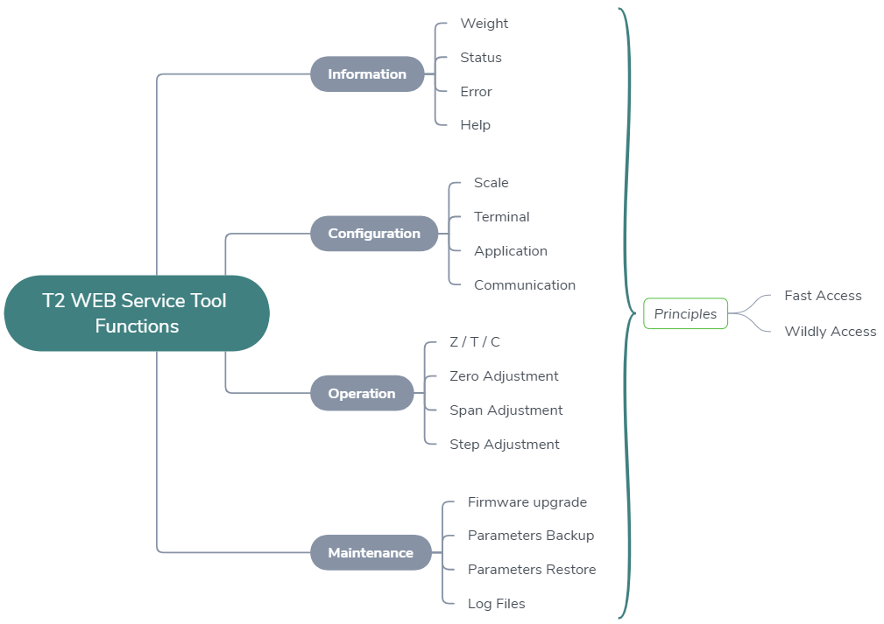
Web Service Functions

Slide 17
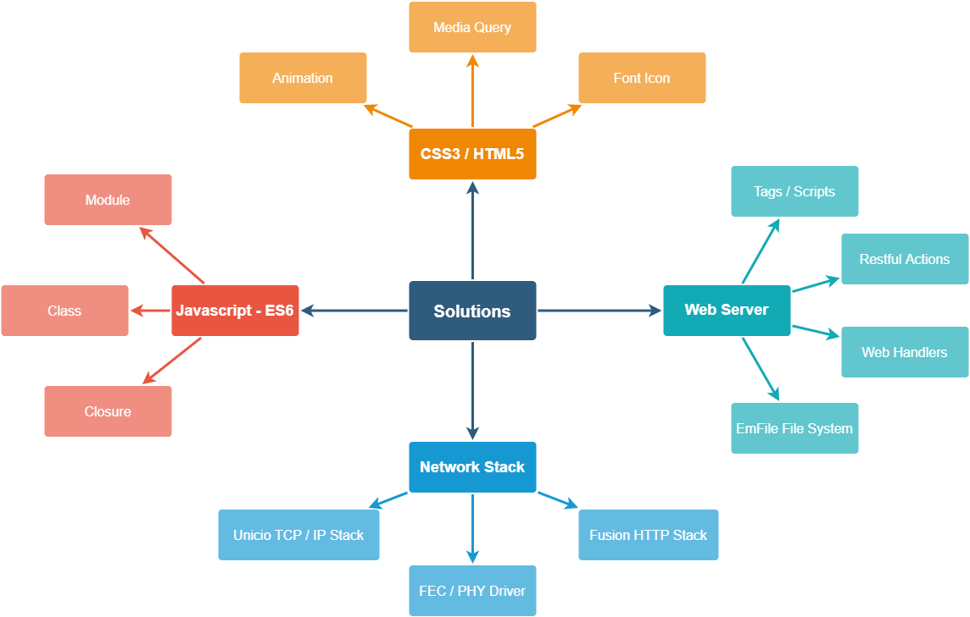
Web Service Technical solution
Notes:
CSS3 / HTML5 – Media / Animation / Font Icon
ES6 – module / class / closure – function as data
Web front end in detail later
Web back end in concrete in this slice
Network stack - Driver tcp/ip http/(https)
web server - one session as for CPU load

Slide 18
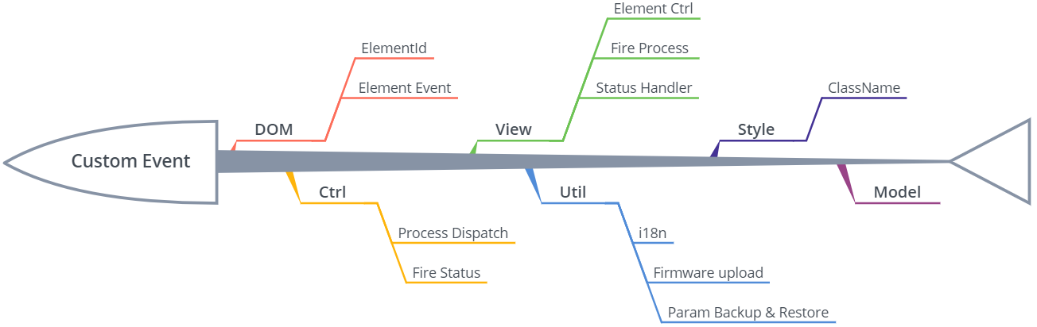
Low Coupling & Hi Cohesion
Custom Event as Bata Bus
Event Type indicate the specific service
Event detail of JSON format

Slide 19
The End
Questions？

